Slide 1
Brief Introduction to Spatial Data Mining
Spatial data mining is the process of discovering interesting, useful, non-trivial patterns from large spatial datasets
Reading Material: http://en.wikipedia.org/wiki/Spatial_analysis

Slide 2

Examples of Spatial Patterns
Historic Examples (section 7.1.5, pp. 186)
  1855 Asiatic Cholera in London: A water pump identified as the source
  Fluoride and healthy gums near Colorado river
  Theory of Gondwanaland - continents fit like pieces of a jigsaw puzlle
Modern Examples
  Cancer clusters to investigate environment health hazards
  Crime hotspots for planning police patrol routes
  Bald eagles nest on tall trees near open water
  Nile virus spreading from north east USA to south and west
  Unusual warming of Pacific ocean (El Nino) affects weather in USA

Slide 3
Why Learn about Spatial Data Mining?
Two basic reasons for new work
  Consideration of use in certain application domains
  Provide fundamental new understanding
Application domains
  Scale up secondary spatial (statistical) analysis to very large datasets
    Describe/explain locations of human settlements in last 5000 years
    Find cancer clusters to locate hazardous environments
    Prepare land-use maps from satellite imagery
    Predict habitat suitable for endangered species
  Find new spatial patterns
    Find groups of co-located geographic features
Exercise. Name 2 application domains not listed above.

Slide 4
Why Learn about Spatial Data Mining? - 2
New understanding of geographic processes for Critical questions
  Ex. How is the health of planet Earth?
  Ex. Characterize effects of human activity on environment and ecology
  Ex. Predict effect of El Nino on weather, and economy
Traditional approach: manually generate and test hypothesis
  But, spatial data is growing too fast to analyze manually
    Satellite imagery, GPS tracks, sensors on highways, …
  Number of possible geographic hypothesis too large to explore manually
    Large number of geographic features and locations
    Number of interacting subsets of features grow exponentially
    Ex. Find tele connections between weather events across ocean and land areas
SDM may reduce the set of plausible hypothesis
  Identify hypothesis supported by the data
  For further exploration using traditional statistical methods

Slide 5

Autocorrelation
Items in a traditional data are independent of each other,
  whereas properties of locations in a map are often “auto-correlated”.
First law of geography [Tobler]:
  Everything is related to everything, but nearby things are more related than distant things.
  People with similar backgrounds tend to live in the same area
  Economies of nearby regions tend to be similar
  Changes in temperature occur gradually over space(and time)
Waldo Tobler in 2000
Papers on “Laws in Geography”: http://www.geog.ucsb.edu/~good/papers/393.pdf
http://homepage.univie.ac.at/Wolfgang.Kainz/Lehrveranstaltungen/Theory_and_Methods_of_GI_Science/Sui_2004.pdf

Slide 6
Characteristics of Spatial Data Mining
Auto correlation
Patterns usually have to be defined in the spatial attribute subspace and not in the complete attribute space
Longitude and latitude (or other coordinate systems) are the glue that link different data collections together
People are used to maps in GIS; therefore, data mining results have to be summarized on the top of maps
Patterns not only refer to points, but can also refer to lines, or polygons or other higher order geometrical objects
Large, continuous space defined by spatial attributes
Regional knowledge is of particular importance due to lack of global knowledge in geography (→spatial heterogeniety)

Slide 7

Why Regional Knowledge Important in Spatial Data Mining?
A special challenge in spatial data mining is that information is usually not uniformly distributed in spatial datasets.
It has been pointed out in the literature that “whole map statistics are seldom useful”, that “most relationships in spatial data sets are geographically regional, rather than global”, and that “there is no average place on the Earth’s surface” [Goodchild03, Openshaw99].
Therefore, it is not surprising that domain experts are mostly interested in discovering hidden patterns at a regional scale rather than a global scale.

Slide 8

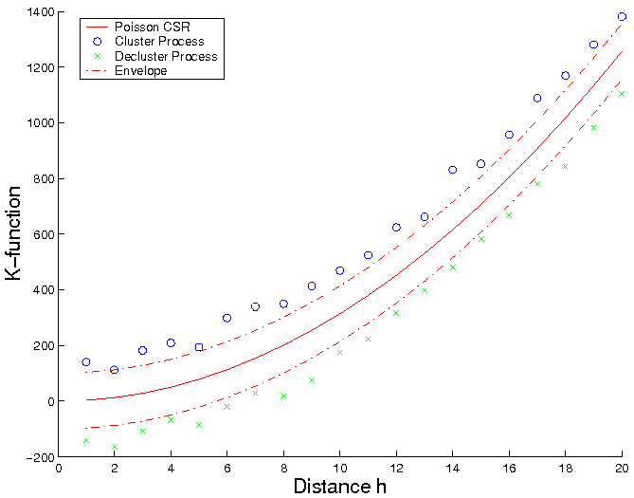

Spatial Autocorrelation: Distance-based measure
K-function Definition (http://dhf.ddc.moph.go.th/abstract/s22.pdf )
  Test against randomness for point pattern
    λ is intensity of event
  Model departure from randomness in a wide range of scales
Inference
  For Poisson complete spatial randomness (CSR): K(h) = πh²
  Plot Khat(h) against h, compare to Poisson CSR
    >: cluster
    <: decluster/regularity
[number of events within distance h of an arbitrary event]
K-Function based Spatial Autocorrelation

Slide 9
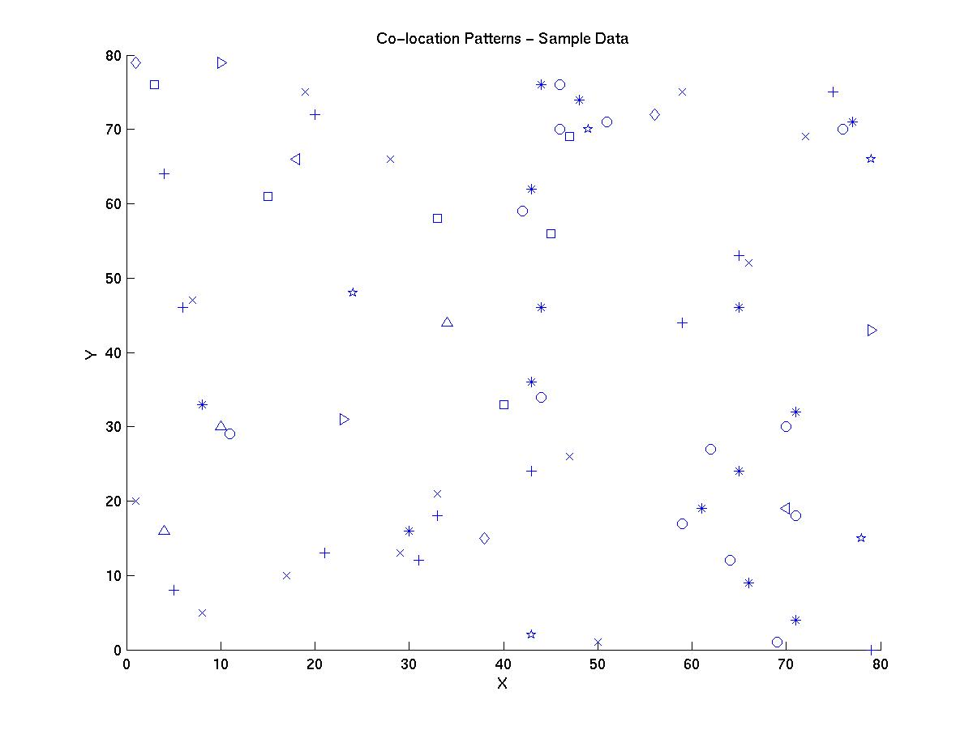









Associations, Spatial associations, Co-location
Answers: and
find patterns from the following sample dataset?

Slide 10
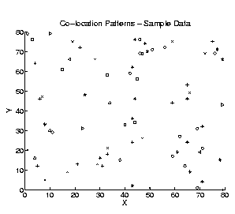
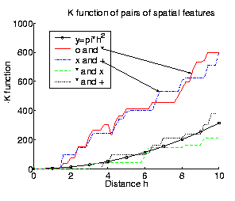
Colocation Rules – Spatial Interest Measures
http://www.youtube.com/watch?v=RPyJwYqyBuI

Slide 11

Cross-Correlation
Cross K-Function Definition
  Cross K-function of some pair of spatial feature types
  Example
    Which pairs are frequently co-located
    Statistical significance
[number of type j event within distance h of a randomly chosen
type i event]

Slide 12
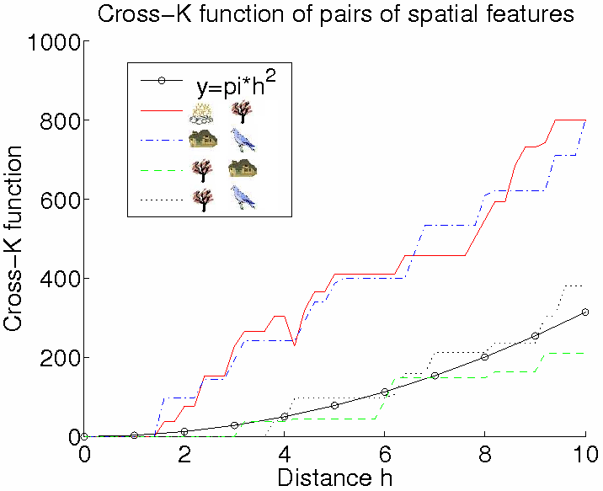

Illustration of Cross-Correlation
Illustration of Cross K-function for Example Data
Cross-K Function for Example Data
Notes:
star - green tree
x - house
circle - fire
asterisk - fired tree
+ - blue bird

Slide 13

Spatial Association Rules
Spatial Association Rules
  A special reference spatial feature
  Transactions are defined around instance of special spatial feature
  Item-types = spatial predicates
  Example: Table 7.5 (pp. 204)

Slide 14
Co-location rules vs. traditional association rules
Association rules
Co-location rules
Underlying space
discrete sets
continuous space
item-types
item-types
events /Boolean spatial features
collection
Transaction (T)
Neighborhood (N)
prevalence measure
support
participation index
conditional probability metric
Pr.[ A in T | B in T ]
Pr.[ A in N(L) | B at location L ]
Participation index = min{pr(f_{i}, c)}
Where pr(f_{i}, c) of feature f_{i} in co-location c = {f₁, f₂, …, f_{k}}:
= fraction of instances of f_{i} with feature {f₁, …, f_{i-1}, f_{i+1}, …, f_{k}} nearby
N(L) = neighborhood of location L

Slide 15
Conclusions Spatial Data Mining
Spatial patterns are opposite of random
Common spatial patterns: location prediction, feature interaction, hot spots, geographically referenced statistical patterns, co-location, emergent patterns,…
SDM = search for unexpected interesting patterns in large spatial databases
Spatial patterns may be discovered using
  Techniques like classification, associations, clustering and outlier detection
  New techniques are needed for SDM due to
    Spatial Auto-correlation
    Importance of non-point data types (e.g. polygons)
    Continuity of space
    Regional knowledge; also establishes a need for scoping
    Separation between spatial and non-spatial subspace—in traditional approaches clusters are usually defined over the complete attribute space
Knowledge sources are available now
  Raw knowledge to perform spatial data mining is mostly available online now (e.g. relational databases, Google Earth)
  GIS tools are available that facilitate integrating knowledge from different source

Slide 16
Examples of Spatial Analysis
http://www.youtube.com/watch?v=ZqMul3OIQNI&feature=related
http://www.youtube.com/watch?v=RhDdtqgIy9Q&feature=related
http://www.youtube.com/watch?v=agzjyi0rnOo&feature=related

